Slide 1
Reflex-based Exercise Study Using Gesture Recognition
Markiyan Varhola

Slide 2
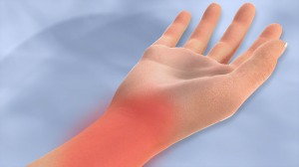
Concept
Computer users often experience hand cramps or pain
Prolonged use can cause health problems such as carpal tunnel syndrome
Can be alleviated by performing regular hand exercise.

Slide 3
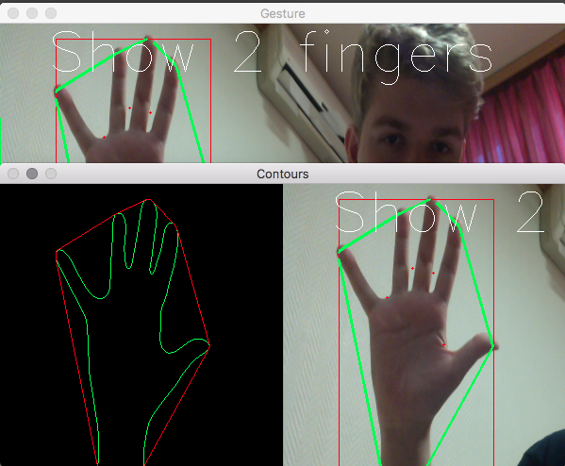
Program
Webcam-based hand gesture recognition
Present the user with an array of fingers to hold up [1,5,2,3,etc.]
Python + OpenCV implementation

Slide 4
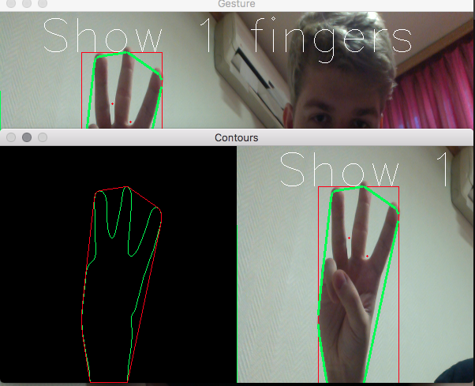
Program
Ask User Age
Start the Timer
The user must complete the tasks presented on screen
End Timer
Record result

Slide 5
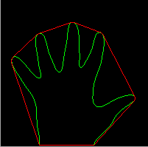
User Study
Two sets of test subjects:
One group gets same pattern each time
Other group gets different test pattern every time
Example:
Group 1: [5,3,1,3] ; [5,3,1,3] ; [5,3,1,3]
Group 2: [5,3,1,3] ; [2,3,1,4] ; [1,2,3,4]

Slide 6
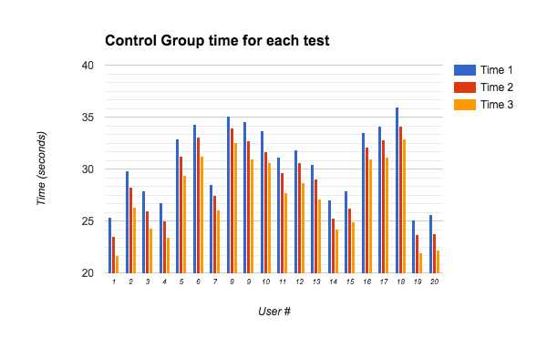
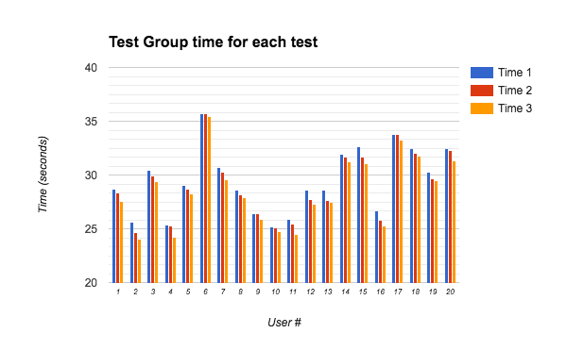
Results

Slide 7
Conclusion
Average Time saving for each test:
Control Group: 1.4825 seconds
Test Group: 0.53875 seconds
The control group was able to shave almost 1.5 seconds off each test, while the test group only shaved about 0.5 off each test.

